Slide 1



IoT & The Cloud
Faculty Workshop
February 14, 2025

Slide 2
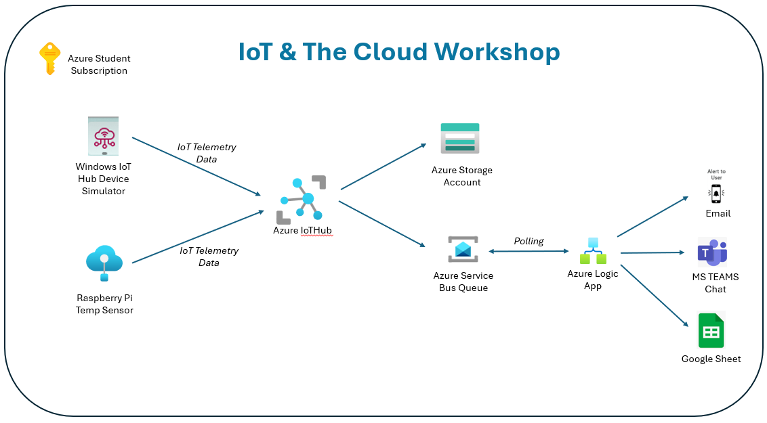
IoT & The Cloud
AGENDA
Welcome & Intros
Goals for the Day
IoT Overview
Raspberry Pi Hardware Setup
Microsoft Azure
Ingesting Telemetry Data
Storing the Data
Alerting on the Data
Futures
DOWNLOAD THE SLIDES HERE TO FOLLOW ALONG:
https://tinyurl.com/5a2dd476

Slide 3

Logistics Discussion
Everyone on the same page?
Help each other out!
CHECKPOINT

Slide 4

Links exist throughout the deck to dive more deeply into some of the topics we cover
Great for followup after the workshop!

Slide 5





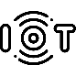

IoT
RPI
AZURE
Internet of Things Overview
Number of humans? – 8.1B
Number of cell phones? – 7B
Number of IoT devices? – 24.4 B
Challenges:
Updating & Managing Devices
Managing Telemetry
Managing Data
Examples
Consumer – locks, doorbells, lightbulbs, cars
Commercial – healthcare, monitoring, security
Industrial – digital control sys, agribiz
Infrastructure – smart cities
Internet of Things

Slide 6

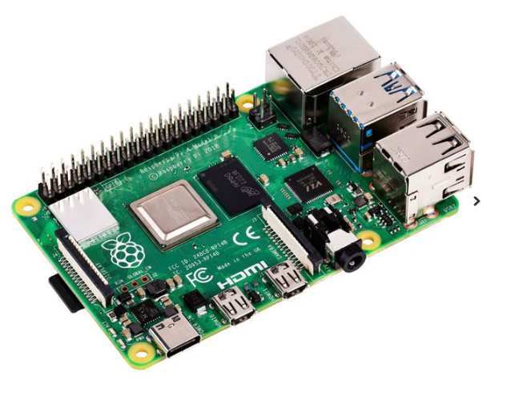

IoT
RPI
AZURE
Raspberry Pi Overview
Pi 4 Model B (circa 2019)
Single Board Computer (SBC)
1.5 GHz 64-bit quad core ARM Cortex-A72 processor
8 GB RAM
HDMI output
802.11n Wi-Fi & Bluetooth
32G SD card w/64-bit Debian (Bullseye)
GPIO – General Purpose I/O
History of Raspberry Pi
Raspberry Pi Model Comparison

Slide 7
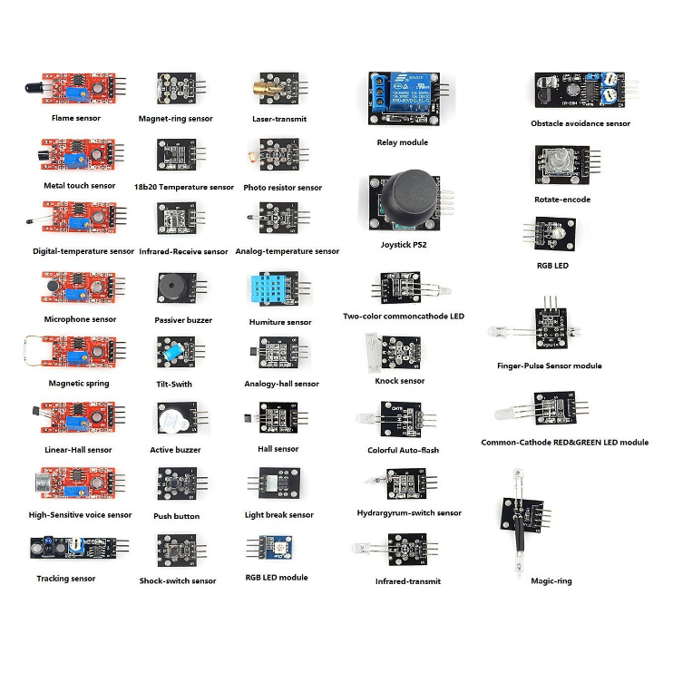
IoT
RPI
AZURE
Raspberry Pi Overview
Many popular IoT type sensors can be connected to GPIO:
Temp
Humidity
Light
Fire
Sound
Motion
IR
Joystick, etc.

Slide 8
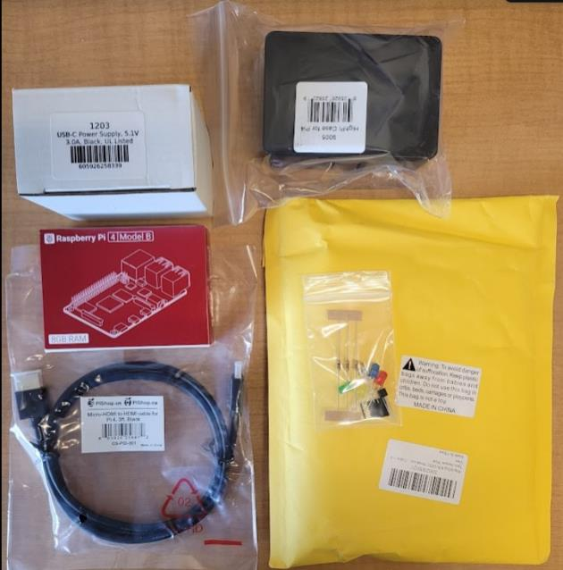
IoT
RPI
AZURE
Raspberry Pi Setup
Raspberry Pi 4 Model B (8GB)
32 GB SD Card with Raspbian OS (Bullseye)
Pi Case
5v Power Supply
Breadboard and Jumper Wires
LEDs & Resistors
GPIO Breakout Ribbon Cable
Micro HDMI Cable
DS18B20 Temp Sensor
What’s in the kit?

Slide 9
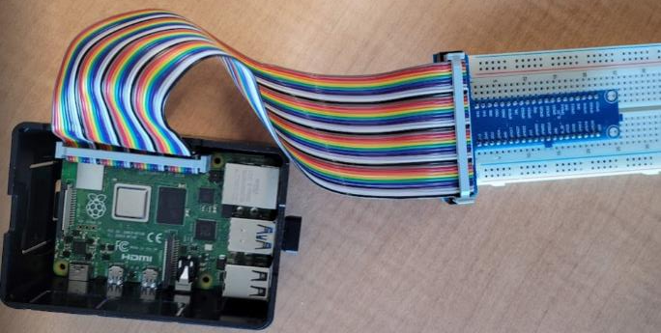
IoT
RPI
AZURE
Raspberry Pi Setup
Cable it up:
Insert pi board into case
Insert SD Card
Connect HDMI monitor
Connect Keyboard
Connect Mouse
Cable GPIO to Breadboard
5v Power supply (do this last!)
Cable the GPIO to the Breadboard via the GPIO Extension Board. Orient the cable on the Raspberry Pi side so that the notch in the gray plastic connector piece faces into the board. On the Extension Board side, the cable will only fit one way (with the notch aligned from the male connector to the slot on the female connector). Plug the Extension Board into the breadboard so that it straddles the middle of the board with the pins pushed into columns d & h in rows 1 thru 20
* Note that there is no on/off switch on this model Pi

Slide 10
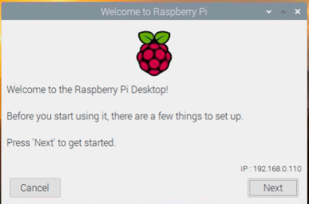
IoT
RPI
AZURE
Raspberry Pi Setup
Initial Startup:
When you first power on the Rapsberry Pi you will see a short series of screens flash by and the system will reboot.
You will then need to complete the initial config process where you set language, country, timezone, username/pswd, etc. You can skip the step where you are prompted to Update Software.
Your machine will restart again and you should then see the main Raspberry Pi desktop.

Slide 11
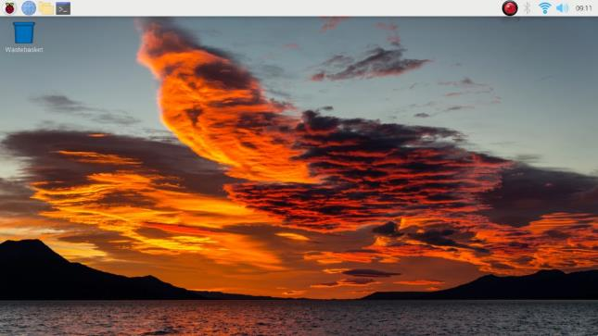
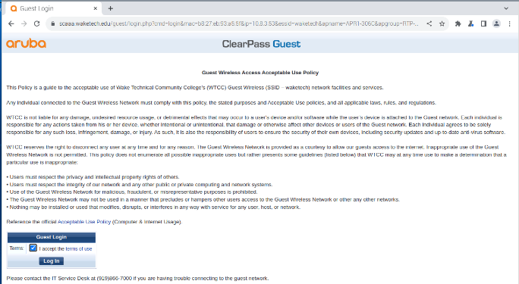
IoT
RPI
AZURE
Raspberry Pi Setup
Initial Startup:
Click the wireless icon in upper right and join the waketech wireless network (if not already joined)
Launch a web browser by clicking the small globe icon in the upper left of the screen
Accept the Aruba guest logon screen agreement in order to use the wireless connection
Check that you can access the internet (you might need to restart your system at this point if not)
2
1
3

Slide 12
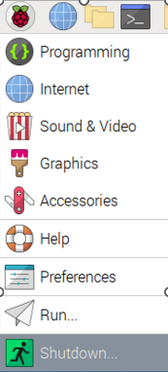
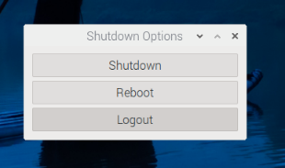
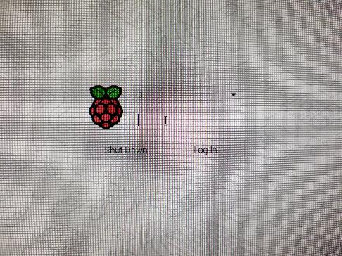
IoT
RPI
AZURE
Raspberry Pi Setup
Initial Startup:
Test the logoff / logon process
Click the raspberry icon in upper left & select the Shutdown menu choice and select Logout
Logout
Log back on with the username / password that you created
1
3
2
4

Slide 13
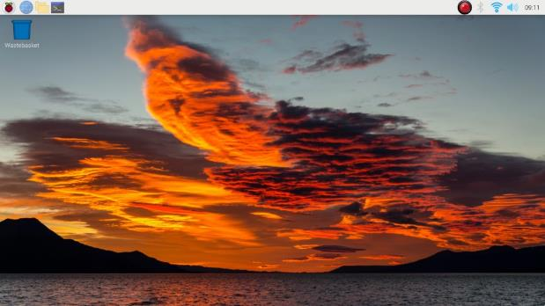
Raspberry Pi rebooted, connected to the network and showing the desktop
CHECKPOINT

Slide 14
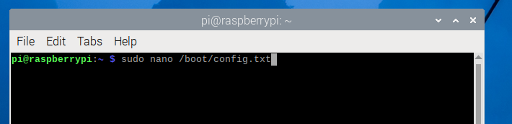
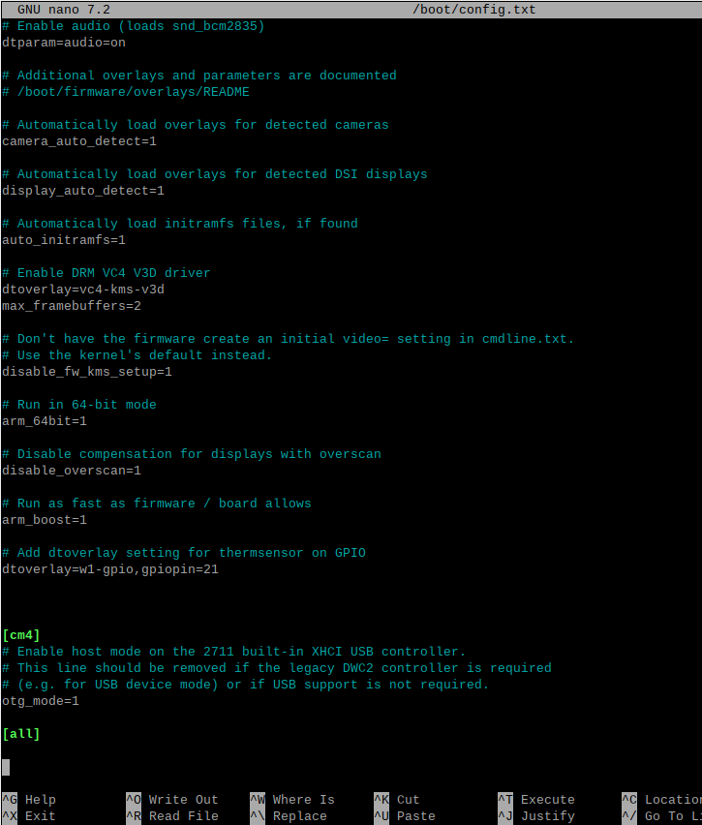
IoT
RPI
AZURE
Raspberry Pi Setup
Config tweak needed for our project:
Launch terminal and run this command
sudo nano /boot/config.txt
Then add these 2 lines at the bottom just before the [cm4] section:
# Add dtoveraly setting for thermsensor on GPIO
dtoverlay=w1-gpio,gpiopin=21
Type CTRL+O to write then CTRL+X to exit
Then reboot (pi menu – Logout -> Reboot)

Slide 15
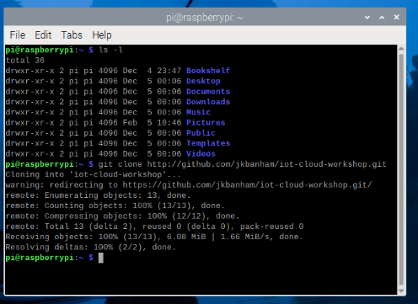
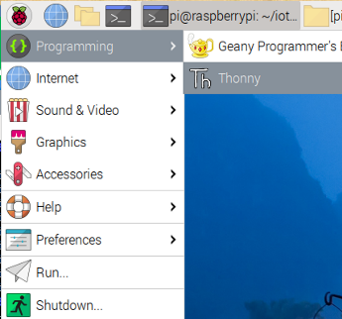
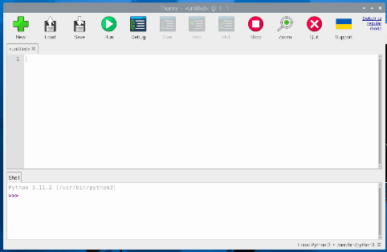
IoT
RPI
AZURE
Raspberry Pi Code
Launch terminal and run this command:
git clone http://github.com/jkbanham/iot-cloud-workshop.git
Note that you should now have a new directory with files we use for this project:
/home/pi/iot-cloud-workshop/
Launch the Thonny IDE from the Pi menu under Programming. Click on the ‘Switch to regular mode’ link in the upper right
Close Thonny and then re-launch it
1
2
3

Slide 16
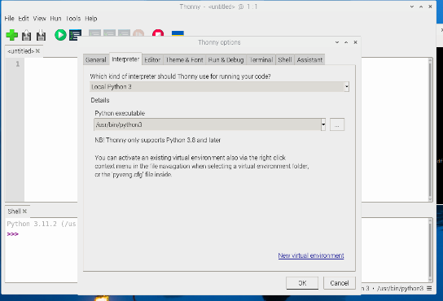
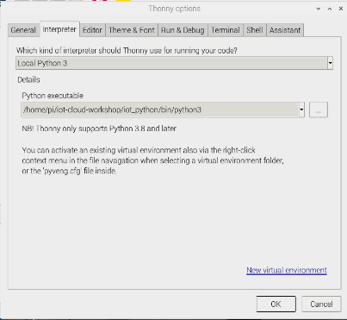
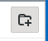
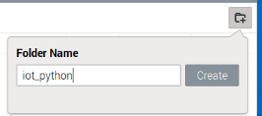
IoT
RPI
AZURE
Raspberry Pi Code
From the ‘Run’ menu, select ‘Configure Interpreter’ and then click the ‘New virtual environment’ link in the lower right
In the dialog box to “Select empty directory for new virtual environment”, browse to the /home/pi/iot-cloud-workshop folder and click the ‘Create Folder icon in the upper right. Type iot_python and click ‘Create’.
Click ‘OK’ at the bottom and the new virtual python environment will be created.
1
2
3
4
5

Slide 17
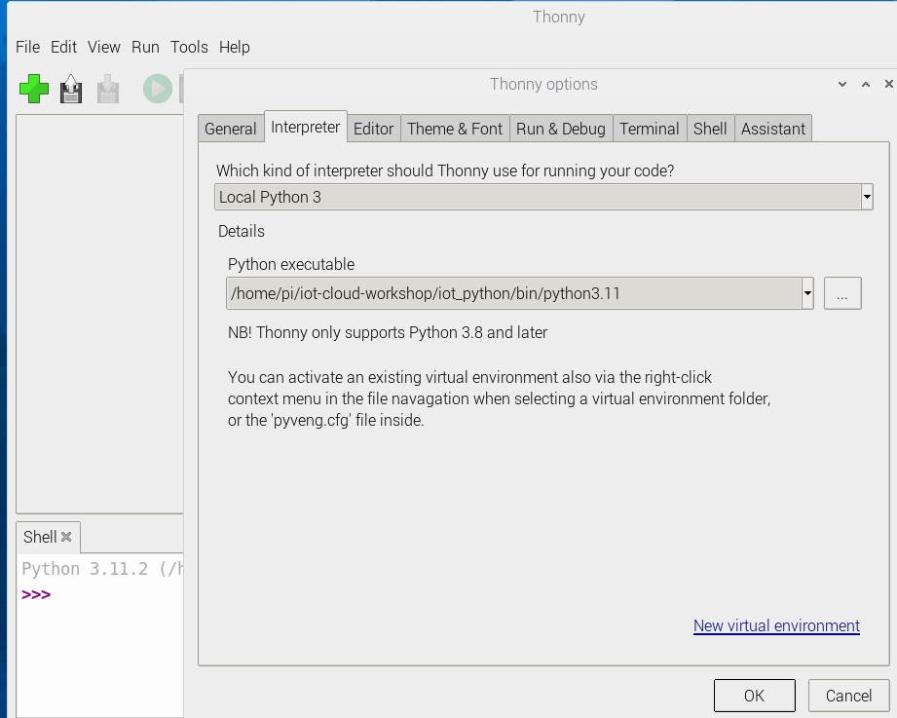
IoT
RPI
AZURE
Raspberry Pi Code
Set the new virtual environment as the default interpreter in the Thonny IDE application:
Open the Tools -> Options menu and select the Interpreter tab
Select the python version 3.9 executable file from the new virtual environment that you created (/home/pi/iot-cloud-workshop/iot_python/bin/python3.9)
Click OK to save
1
2
3
4

Slide 18
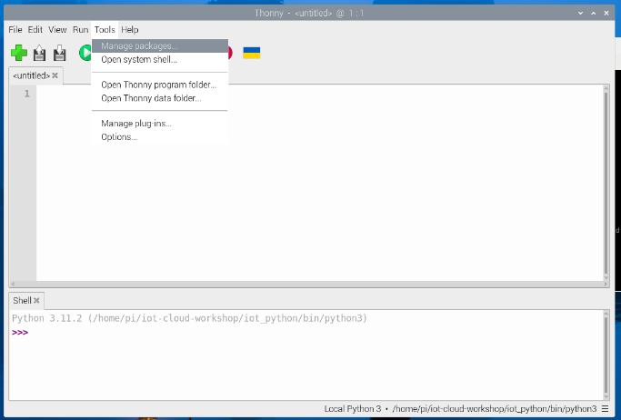
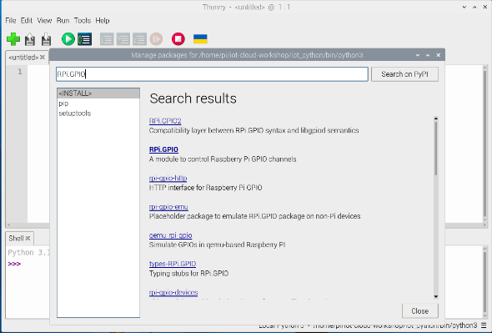
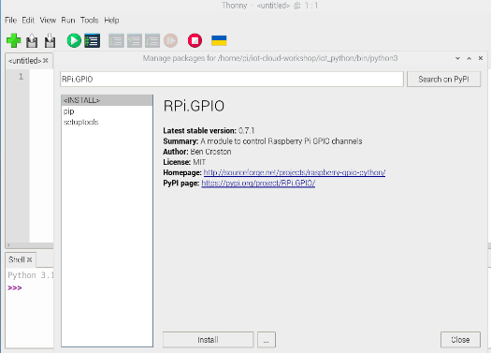
IoT
RPI
AZURE
Raspberry Pi Code
Open the Tools -> Manage Packages menu
Type RPi.GPIO (note lowercase ‘i’) in the Search on PyPIW1therm box and then click the module when it appears and then click the Install button in lower left
Repeat the same process described above for the W1thermsensor module and also the azure-iot-device and asyncio modules
1
2
3

Slide 19
Git repo cloned, Thonny launched, Python virtual environment created, Python modules installed
Check & Compare with Instructor’s Screen View
CHECKPOINT

Slide 20
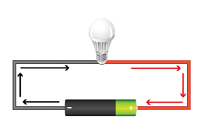
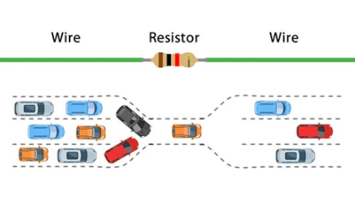
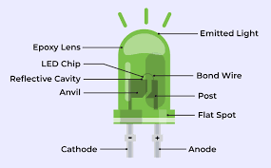
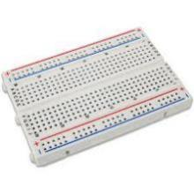
IoT
RPI
AZURE
Raspberry Pi Sensor
Some key concepts:
Voltage
Polarity
Resistors
LEDs
Breadboard
More info about circuits

Slide 21
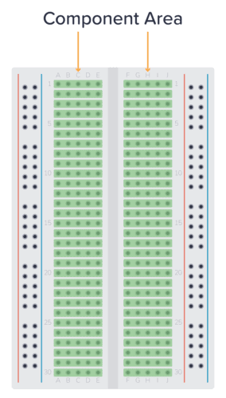
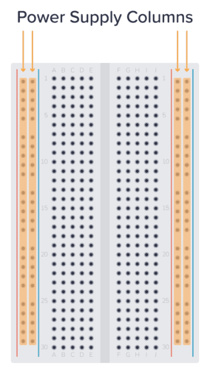
IoT
RPI
AZURE
Raspberry Pi Sensor
What is a breadboard?
Used for easy electronic circuit prototyping – no soldering required
The story is that a vacuum tube engineer drove nails into his kitchen bread cutting board and connected them with wires
Power supply columns are common (red/pos & blue/neg) Numbered rows in component area are common (on each side only – no commonality across middle gap)
More info about breadboards

Slide 22
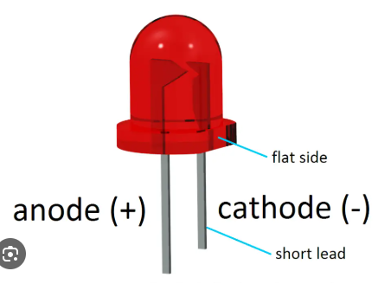
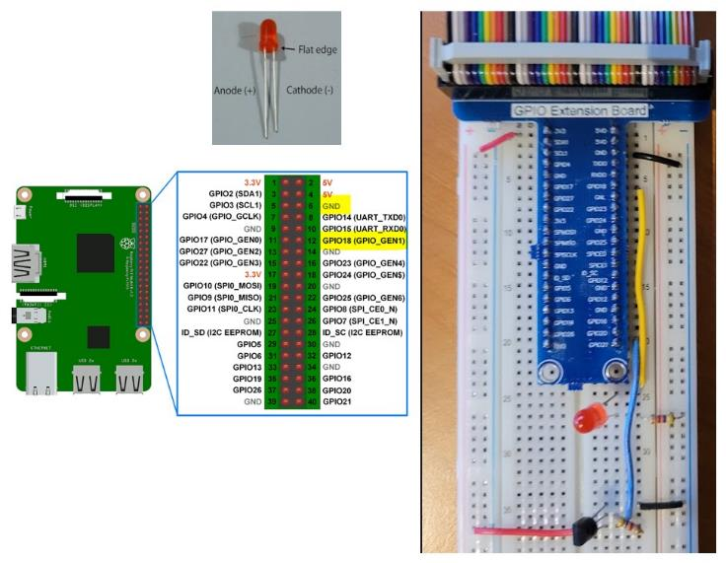
IoT
RPI
AZURE
Raspberry Pi Sensor
Make the following connections on your breadboard:
Plug the red LED into the breadboard with the short leg (cathode (-)) in row 27 column h and the long leg (anode (+)) in row 25 column h
Plug a resistor between row 27 column j and the negative (blue) rail on the right side of the breadboard
Plug a jumper wire from pi pin 6 (GND - row 3, col j) to the blue rail on the right side of the breadboard
Plug a jumper wire from pi pin 12 (GPIO18 – row 6, col j) on the Raspberry Pi breakout board to row 25 column j
How does an LED work?
Using GPIO pins with LEDs

Slide 23
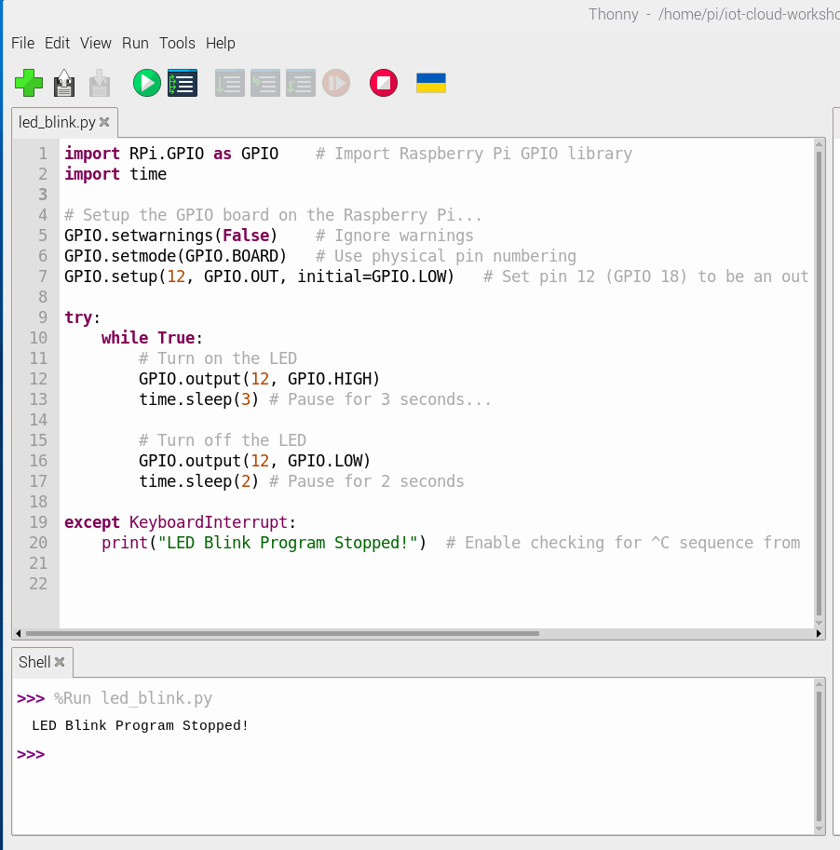

IoT
RPI
AZURE
Raspberry Pi Code
In the Thonny IDE, open the file named /home/pi/iot-cloud-workshop/led_blink.py
Read through the code and ask any questions you might have
Click the button and check to see if your LED starts to blink
Press CTRL+C to stop the program
Thonny screenshot – open file

Slide 24
Code runs successfully to blink the LED
CHECKPOINT

Slide 25
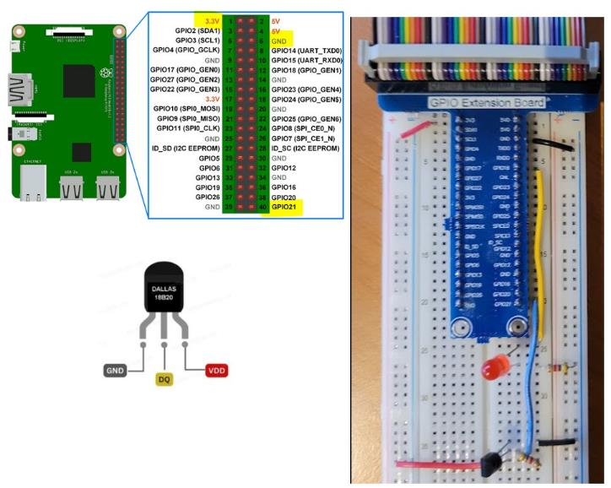
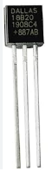
IoT
RPI
AZURE
Raspberry Pi Sensor
Make the following connections on your breadboard:
Plug your DS18B20 sensor into the board with pin 1(GND) in row 35 column g, pin 2(DATA) in row 36 column g, and pin 3 (voltage) in row 37 column g on the breadboard
Plug a resistor between rows 36 & 37 in col h
Plug a jumper wire from row 35 col j to the blue ground rail on right-hand side of the breadboard (note that we connected this groundrail to pin 6 on the breakout board in an earlier step)
How does the DS18B20 work?

Slide 26
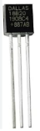
IoT
RPI
AZURE
Raspberry Pi Sensor
Make the following connections on your breadboard:
Plug a jumper wire from row 36 col j to pi pin 40 (GPIO21 – row 20, col j) on the breadboard
Plug a jumper wire from pi pin 1 (3.3V - row 1, col a) to the red rail on the left side of the breadboard
Plug a jumper wire from row 37 col j to the red rail on the left side of the breadboard
NOTE: It is not required but is best practice to use red/orange wires for voltage and black/brown wires for ground.
How does the DS18B20 work?

Slide 27
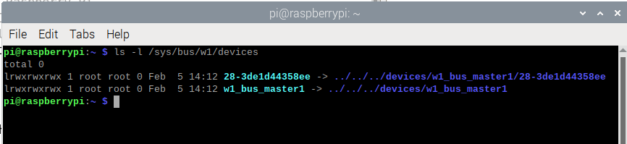
IoT
RPI
AZURE
Raspberry Pi Sensor
Open a terminal and type:
ls –l /sys/bus/w1/devices
If you see an output line starting with "28-“ then you have set things up correctly and there is an active temp sensor connected to your Pi! (If you don’t see it then something is wrong and troubleshooting is needed!)
* NOTE: If you wire the DS18B20 backwards it will get extremely hot and can potentially melt and damage your breadboard/GPIO pins.

Slide 28
Everyone can see the sensor in the /sys/bus/w1/devices folder
CHECKPOINT

Slide 29
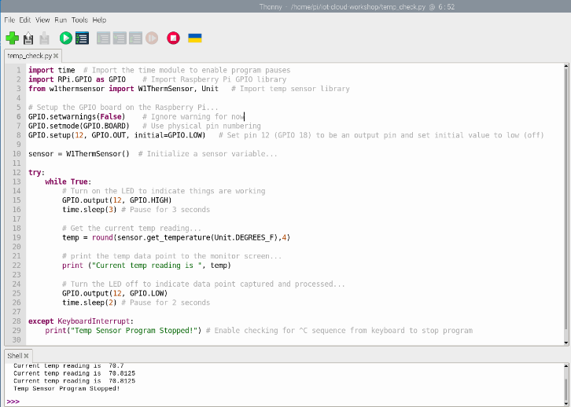
IoT
RPI
AZURE
Raspberry Pi Code
In the Thonny IDE, open the file named /home/pi/iot-cloud-workshop/temp_check.py
Read through the code and ask any questions you might have
Click the button and check to see if temp readings print to the program output shell tab
Press CTRL+C to stop the program

Slide 30
Code runs successfully to blink the LED and print the temp reading to the screen
Test putting your fingers on the temp sensor to watch the readings change
CHECKPOINT

Slide 31

LUNCH BREAK

Slide 32

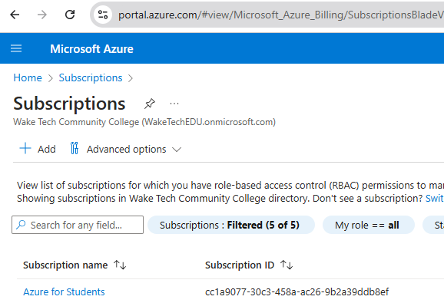

IoT
RPI
AZURE
Microsoft Azure
STEP 1: Confirm Azure Student Subscription Access
This step should have been completed prior to the workshop
Confirm that you can log in to portal.azure.com and confirm you have access to an Azure for Students subscription.

Slide 33
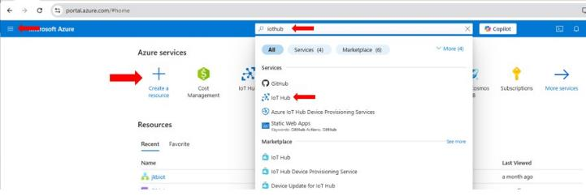
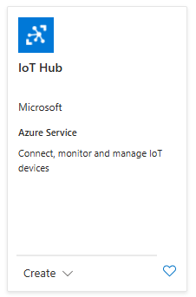
IoT
RPI
AZURE
Microsoft Azure
STEP 2: Create an Azure IoTHub Resource
Click on Create a resource from the left-hand nav menu (hamburger) or from the main Azure services link at the top
In the search bar, type IoT Hub and select IoT Hub from the dropdown list.
Click on Create.
1
2
1
2
3
Azure IoTHub

Slide 34
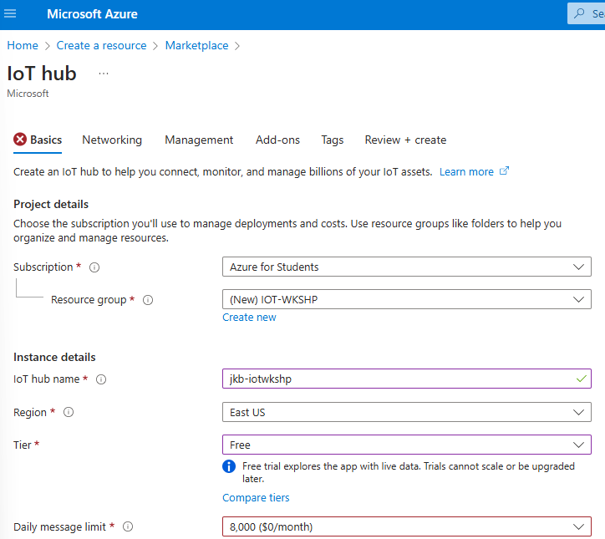
IoT
RPI
GCP
Microsoft Azure
STEP 3a: Configure the IoTHub
Subscription: Select the Azure for Students subscription.
Resource Group: Click on Create new and name the new resource group IOT-WKSHP .
IoT Hub Name: Enter <yourinitials>-iotwkshp as the IoT hub name - for example, I named mine jkb-iotwkshp
Region: Set this to East US
Tier: Set this to Free
Leave all other settings at default and click the Review + create button
1
2
3
4
5
6

Slide 35
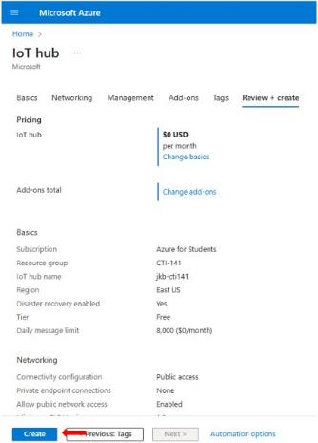
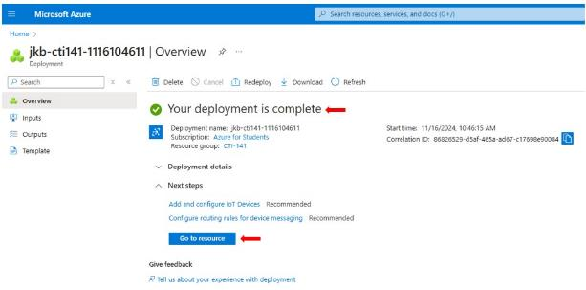
IoT
RPI
GCP
Microsoft Azure
STEP 3b: Additional Configuration
Review all the settings you have configured for your IoT Hub and then click the Create button in the lower left
Azure will start deploying your IoT Hub. This process may take a few moments. Once deployment is complete, you will receive a notification, and you can click on Go to resource to access your new IoT Hub.
1
2

Slide 36
Everyone has a new Azure IoTHub resource created
CHECKPOINT

Slide 37
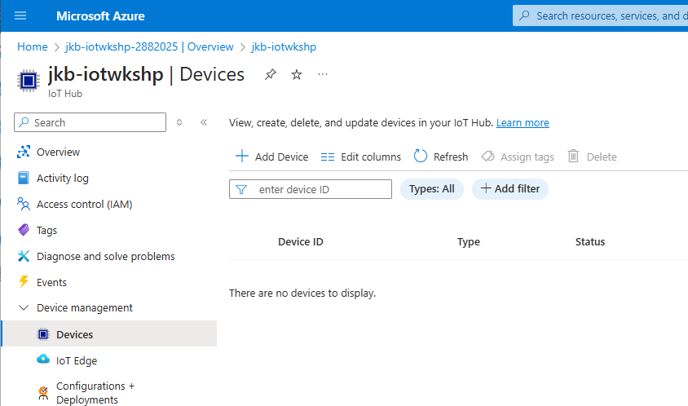
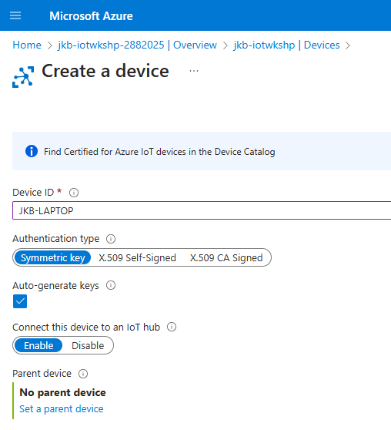
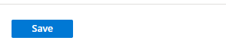
IoT
RPI
Azure
Microsoft Azure
STEP 4a: Add a New Device to Your IoTHub
Open the Device Management -> Devices screen from the left-hand nav menu.
Click on the + Add Device link
Give the new device a unique Device ID name – use anything you like. I used JKB-LAPTOP in this example
Leave all other settings as defaults and click the Save button at the bottom.
2
1
3
4

Slide 38
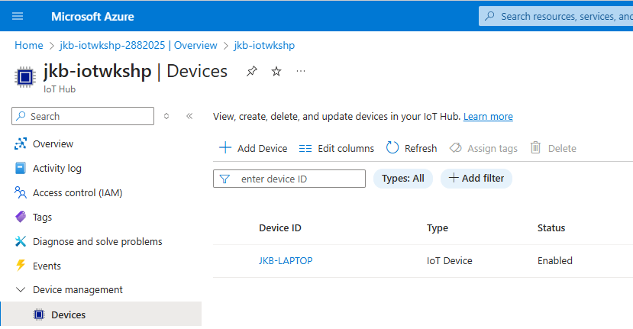

IoT
RPI
Azure
Microsoft Azure
STEP 4b: Copy the Device Connection String
Your new device will appear in the list of devices. Click on it to open its properties.
Click the copy icon to the right of the Primary connection string for your device. This is the authentication key that will be used to allow your IoT device simulator to securely communicate with your IoTHub.
1
2
* Hint – save the primary connection string value into a text file!

Slide 39




IoT
RPI
Azure
Microsoft Azure
STEP 5: Register Your Device
Launch the IoT Device Simulator app on your classroom desktop computer and click the + to add a new IoT device:
Paste in the device connection string from the previous slide and click the Add button
Start the device. You can start and stop the simulated device as needed. Note that while it is running you will be sending data into your Azure IoT Hub.
1
2
3

Slide 40


IoT
RPI
Azure
Microsoft Azure
STEP 6: Add a Custom Message Data Variable.
Click the Settings (gear) icon in the upper right
Click the Add Sensor button
Name the new sensor temp
Set the Value Type to Integer
Set the Maximum Value to 99
Click the Update button at the bottom. Your device simulator will now send a data value into the IoT Hub with a random value between 0 and 99
1
2
3
4
5
6

Slide 41

IoT
RPI
Azure
Microsoft Azure
STEP 7: Observe Device Activity in Azure IoT Hub
Back in the Azure Portal, open your IoT Hub resource, and observe the message activity on the Overview screen.

Slide 42


IoT
RPI
Azure
Microsoft Azure
STEP 8a: Azure IoT Explorer
Open your IoTHub resource, expand the Security Settings menu on the left and select Shared access policies
Click the iothubowner policy
Copy the Primary connection string
1
1
2
3
* Hint – save the primary connection string value into a text file!

Slide 43




IoT
RPI
Azure
Microsoft Azure
STEP 8b: Azure IoT Explorer
Launch the Azure IoT Explorer app on your classroom desktop computer and click the + Add connection button
Paste in the connection string from step 8a and click the Save button
The next screen will show the currently registered devices in your IoTHub. Click the device you created.
1
2
2
3

Slide 44



IoT
RPI
Azure
Microsoft Azure
STEP 8c: Azure IoT Explorer
Select the Telemetry screen
Click the Start button
In your IoT Hub Device Simulator app, click the start arrow for your device
Back in the Azure IoT Explorer add, observe the Receiving events window at the bottom of the screen
2
1
3
4
What is a JSON file

Slide 45
Everyone can see simulated IoT device data being received in their Azure IoTHub
CHECKPOINT

Slide 46

IoT
RPI
Azure
Microsoft Azure
STEP 9a: Create an Azure Storage Resource
Back in the Azure Portal, click on Create a resource from the left-hand nav menu (hamburger) or from the main Azure services link at the top
In the left-hand menu, under categories, scroll down to Storage and click on it.
Click the Create button under Storage account
1
3
2

Slide 47

IoT
RPI
Azure
Microsoft Azure
STEP 9b:
On the next screen be sure that the resource group is set to IOT-WKSHP
Add a Storage account name of <your_initials>iotwkshp
Click the Review + create button at the bottom. It will take a few moments to validate and then you should click the Create button at the bottom. It will take a few more moments to deploy.
1
2
2
3

Slide 48

IoT
RPI
Azure
Microsoft Azure
1
STEP 10a: Set Storage Account as an IoT Hub Endpoint
Back in your main IoT Hub screen, expand the Hub settings menu on the left-hand side and then open the Message routing screen.
Click the Custom endpoints tab and
Click the + Add button at the top

Slide 49

IoT
RPI
Azure
Microsoft Azure
STEP 10b: Set the Storage Account as an IoTHub Endpoint
On the next screen, select Storage from the Endpoint type pick-list.
Set the Endpoint name to IOTWKSHP
Change the Encoding radio button to JSON.
Click the Pick a container button
1
2
4
3

Slide 50

IoT
RPI
Azure
Microsoft Azure
STEP 10c: Set the Storage Account as an IoTHub Endpoint
On the next screen, select your storage account and the Containers screen will open.
Click the + Container link and the New container properties will open on the right side. Give your new container a name of iot-device-data You can think of this as a folder that will be used to store your IoT device files.
Click the Create button at the bottom right

Slide 51




IoT
RPI
Azure
Microsoft Azure
STEP 10d: Set the Storage Account as an IoTHub Endpoint
On the next screen, click on your newly created container so that is selected and then click the Select button at the bottom. This will take you back to the Endpoint screen and you can click the Create + next button at the bottom of the screen.
On the next screen, enter an Endpoint name for the route (you can use iotwkshp again).
Finally, click the Create + skip enrichments button at the bottom. It will take a few moments to save the new endpoint.
1
1
2
3

Slide 52

IoT
RPI
Azure
Microsoft Azure
STEP 10e: Observe Data in Storage
Restart your IoT Hub Device Simulator app. Telemetry data should now start to accumulate in your Azure storage account.
In your Azure storage account, and scroll down and expand Data storage menu
Click to open the Containers screen
Click to open the new iot-device-data container that you previously created
There is sometimes a lag before you can see it so be sure to wait a few minutes or so if you don't immediately see anything after completing the previous steps. Use the Refresh button if needed
5
4
2
3

Slide 53

IoT
RPI
Azure
Microsoft Azure
STEP 10f: Observe IoT Device Telemetry Data Saved to Azure Storage Account
You can now drill down into the container folder structure until you find the actual data files (they will have an extension of .json). Note that the body element in these json files is encoded (Base64) and would require a decoding process before it could be used as human-readable text.
What is a JSON file
Why Use Base64 Encoding?

Slide 54
Everyone can see IoT device telemetry data being saved into an Azure Storage container
CHECKPOINT

Slide 55

IoT
RPI
Azure
Microsoft Azure
Triggering an Azure Workflow
We'll now update our Iot Hub resource to use an Azure Logic App to trigger different workflow activities (such as triggering an email alert) when an IoT message arrives into an Azure message service bus queue.
We will use the temperature data that is being sent in by our simulated IoT devices to trigger an email alert when the temp level exceeds a certain setting.

Slide 56

IoT
RPI
Azure
Microsoft Azure
STEP 11a: Create an Azure Service Bus Namespace & Queue
In the Azure portal, click on Create a resource from the left-hand nav menu (hamburger) or from the main Azure services link at the top
In the search bar, type service and select Service Bus from the dropdown list.
1
2
1
2
Azure Service Bus & Namespace Info

Slide 57

IoT
RPI
Azure
Microsoft Azure
STEP 11b: Create an Azure Service Bus Namespace & Queue
On the next screen Click on the + Create button in the upper left. On the Create namespace screen that comes up next, pick the IOT-WKSHP Resource group
Set the Namespace name to iotwkshp
Select the Basic Pricing Tier
Click the Review + create button in the lower left - It will take a moment to validate
1
2
3
4

Slide 58

IoT
RPI
Azure
Microsoft Azure
STEP 11c: Create an Azure Service Bus Namespace & Queue
Click Create - once the deployment completes then click the Go to resource button.
On the Overview page of your Service Bus namespace, click the + Queue button.
In the Create queue screen that appears on the right side, enter iotwkshp for the Name
Click the Create button at the bottom
2
3
4

Slide 59

IoT
RPI
Azure
Microsoft Azure
STEP 11d: Create an Azure Service Bus Namespace & Queue
In your Service Bus namespace screen that appears, expand the Settings menu on the left-hand side
Select Shared access policies
Click on the RootManageSharedAccessKey policy to open its details.
Copy the value of the Primary Connection String and save it for later use (paste into a text file)
3
1
2
4

Slide 60
Everyone has a Service Name Space Bus & Queue created and has saved the Primary Connection String to a text file
CHECKPOINT

Slide 61

IoT
RPI
Azure
Microsoft Azure
STEP 12a: Add Custom Endpoint
Open your IoT Hub resource and expand the Hub settings menu on the left-hand side
Open the Message routing screen.
On the Routes tab, click the checkbox to the left of the existing iotwkshp route. Since we are using the free version of IoTHub we are limited to only one route/endpoint so we will delete this route/endpoint before creating a new one for this step.
Click the Delete button in the middle portion of the screen.
Once the route is deleted, click on the Custom endpoints tab.
1
4
2
3

Slide 62

IoT
RPI
Azure
Microsoft Azure
STEP 12b: Add Custom Endpoint
Click the checkbox to the left of your existing IOTWKSHP Storage endpoint. Since we are using the free version of IoT Hub we are limited to only one endpoint so we will delete this endpoint before creating a new one for this step.
Click the Delete button in the middle portion of the screen.
Finally, click the + Add button at the top
3
2
1

Slide 63


IoT
RPI
Azure
Microsoft Azure
STEP 12c: Add Custom Endpoint
Select Service bus queue from the Endpoint type pick-list.
Enter iotwkshp as the Endpoint name
Select iotwkshp from the drop-down list for both the Service bus namespace and Service bus queue.
Click Create + next at the bottom of the screen
Once the endpoint is created, you will automatically move to the Route tab. Name the route iotwkshp
Click Create + skip enrichments button at bottom
1
2
3
3
5
4
6

Slide 64
Everyone has successfully created a custom endpoint and routing rule
CHECKPOINT

Slide 65



IoT
RPI
Azure
Microsoft Azure
STEP 13a: Configure a Logic App
From the Azure Home screen, create a new Azure Logic App resource.
Select the Consumption / Multi-tenant hosting option
Pick your IOT-WKSHP Resource group and use iotwkshp for the Logic App name. You can accept all other default values
Click the Review + create button in the lower left. Once the settings are validated, click Create in the lower left. After a few moments the deployment will complete and you can click the Go to resource button.
1
2
3
3
4

Slide 66


IoT
RPI
Azure
Microsoft Azure
STEP 13b: Configure a Logic App
The Logic App screen will appear. Expand the Development Tools menu on the left-hand side
Click the Logic app designer choice.
Click the Add a trigger button in the middle of the screen
Type service into filter box on the Add a trigger properties screen on the right side.
Click the When a message is received in a queue... button under the Service Bus group.
4
1
2
3
5

Slide 67

IoT
RPI
Azure
Microsoft Azure
STEP 13c: Configure a Logic App
The Create connection properties pane will appear on the right-hand side. Use the name iotwkshp for the Connection Name field
Paste in the Connection String that you copied in Step 11d.
Click the Create new button.
1
2
3

Slide 68

IoT
RPI
Azure
Microsoft Azure
STEP 13d: Configure a Logic App
On the When a message is received... pane select iotwkshp from the Queue name pick list
Click the Save button in the upper left portion of the screen.
Click the + button in the middle of the screen to add the next step to the logic app.
2
1
3

Slide 69

IoT
RPI
Azure
Microsoft Azure
STEP 13e: Configure a Logic App
In the Add an action pane that appears on the right type office 365 into the filter screen
Click on the Send an email(V2) action button.

Slide 70

IoT
RPI
Azure
Microsoft Azure
STEP 13f: Configure a Logic App
You will be prompted to sign in to your Outlook365 account (standard Wake Tech key account login) and then the Send an email (V2) properties pane will appear. Fill in the parameters of the email message as in the example on the right (be sure to use your own email address in the To field)
Click the Save button.
Your logic app is now ready to process IoT device messages and send notifications to your email account.
2
1

Slide 71
Everyone has successfully configured the Logic App
Start up the IOT Hub Device Simulator app and let it run long enough to generate a message or 2 (~30 seconds). The polling cycle for our logic app to check the service bus queue is set by default to 3 minutes so you might have to wait a short time but if things are configured correctly, you should receive a few email messages alerting you to the arrival of IoT messages in your IoT Hub.
CHECKPOINT

Slide 72



IoT
RPI
Azure
Microsoft Azure
Troubleshooting Tips
On the Overview screen of your Azure Logic App you can click on the Trigger history tab to see if/when your logic app is polling the service bus queue (and if it’s finding anything)
You can also view the Runs history tab and drill into the individual runs for details on any errors that occur
Finally, be aware that you can reduce the polling interval on the queue polling cycle if you don’t want to wait 3 minutes between each poll
2
1
2
3

Slide 73

IoT
RPI
Azure
Microsoft Azure
Adding Conditional Logic
In this step, we will explore some of the true power of the Azure Logic resource. The diagram on the right shows an expanded Logic App where we parse the contents of the IoT device message, pull out the temp data and then decide whether to send an email or open a Teams chat based on that value.

Slide 74


IoT
RPI
Azure
Microsoft Azure
STEP 14a: Add Conditional Logic
Open your existing iotwkshp Azure Logic and launch the Logic app designer tool. Click the + icon below the initial trigger event box and click Add an action.
In the Add an action panel, find the Initialize variable action and select it. Play around with the interface to become familiar with it and configure the action as shown on the right.
1
2
Note that you can change the name of an action by clicking it (In the picture above I have changed the default Initialize variable action name to Initialize msgbody variable. Also, note that the Value setting for the variable can be built by drilling down through the available Functions and Dynamic content values. It may be simplest for you just to copy what you see above.
Note that the key to understanding this step is that we are taking the initial message that arrives in the service bus queue, decoding it (it defaults to being base64 encoded) and then storing it into a variable so that we can make a conditional decision about what to do with it.

Slide 75

IoT
RPI
Azure
Microsoft Azure
STEP 14b: Add Conditional Logic
Note that you can change the name of an action by clicking it (I have changed the default Initialize variable action name to Initialize msgbody variable.
The value setting for the variable can be built by drilling down through the available Functions and Dynamic content values. It may be simplest for you just to copy the text below:
base64ToString(triggerBody()?['ContentData'])
1
2

Slide 76


IoT
RPI
Azure
Microsoft Azure
STEP 14c: Add Conditional Logic
We now have the IoT message in a variable that the Azure Logic resource can access and split it into its component parts. The message is in JSON format so we will use a second Azure Logic action to parse it.
Click the + icon below the Initialize variable action box. In the Add an action panel, find / select the Parse JSON action.
Configure it as shown in the screenshot on the right. You can copy-paste the text if needed
2
1
{
"type": "object",
"properties": {
"name": {
"type": "string"
},
"temp": {
"type": "integer"
}
}
}
3
Link for copy paste here: https://tinyurl.com/4dtph495

Slide 77


IoT
RPI
Azure
Microsoft Azure
STEP 14d: Add Conditional Logic
Now we have the temp value sent in by the device in a variable that the Azure Logic app can use to make a decision.
Click the + icon below the Parse JSON action box.
In the Add an action panel, find the Condition action and select it.
Configure as shown. Click the lightning bolt icon to add the Body temp variable. Set the condition to is greater than and enter 75 for the value.
1
2
3

Slide 78


IoT
RPI
Azure
Microsoft Azure
STEP 14e: Add Conditional Logic
Send an Email When Condition is True:
Drag the Send an email (V2) action box that you had previously created into the True branch of the conditional block.
Note that if you want to edit and improve the message you now have access to the device message elements as shown in the example on the right.
1
2

Slide 79

IoT
RPI
Azure
Microsoft Azure
STEP 14f: Add Conditional Logic
Start a Microsoft Teams Chat When Condition is False:
Click the + icon below the False box in the conditional block.
In the Add an action panel, find the Post message in chat or channel action and select it (try searching for TEAMS if you can't find it easily).
Configure it as shown on the right.
2
1
3
Note that you will have to log in to Teams using your Wake Tech credentials in order to configure this action. Be sure to set the Recipient field to your own email address.

Slide 80

IoT
RPI
Azure
Microsoft Azure
STEP 14g: Add Conditional Logic
Be sure to save all of your changes. You can now launch either the IoT Hub Device Simulator app on your computer and let it run for 30 seconds or so to generate some message traffic into your IoTHub. If you have configured things correctly, and depending on the value of the temp variable, you will receive either an email or a new Teams chat. Note that you can also drill into the Run history of the Azure Logic App to get further detail if you need to troubleshoot.
1
2

Slide 81
Everyone has a working logic app that triggers email messages or TEAMS chats when data comes into IoTHub from the device simulator
CHECKPOINT

Slide 82




IoT
RPI
Azure
Microsoft Azure
STEP 15: Raspberry Pi IoT
In your Azure IoT Hub resource, add a new device to identify your Raspberry Pi.
Give the new device a Device ID of RPI-IOT and click Save
Click on the new device to open its properties and copy the Primary connection string value to a text file for later use
1
2
1
2
3

Slide 83

IoT
RPI
AZURE
Raspberry Pi Code
In the Thonny IDE, open the file named
/home/pi/iot-cloud-workshop/azure_temp_sensor.py
Edit lines 10 to include the new device name that you created for your Raspberry Pi in step 15a. Note that the quotes around the variable need to remain in the code.
Click the button and check to see if temp readings print to the screen
3
1
2

Slide 84




IoT
RPI
AZURE
Raspberry Pi Code
Read through the code and see if you can follow what it is doing. Note that this code is a bit more complex than in the prior steps but the main concept of what is doing should still be clear.
If things are configured correctly, temp readings should print to your screen and your Azure logic app should also be triggering alerts.
Remember that you can check the details of the Azure logic app Runs history on the Overview screen of the logic app for troubleshooting assistance.
Press CTRL+C to stop the program

Slide 85
Everyone has their Raspberry Pi sending temp sensor readings into the IOTHub and is seeing alerts generated!
CHECKPOINT

Slide 86


IoT
RPI
Azure
Microsoft Azure
Note about Azure resource cleanup!
The Azure resources that you have created today will consume ~ $0.10 per day against your free subscription value. You can view the daily costs in the Cost management section of the Azure Portal. You will receive an invoice via email each month (but costs will show as $0.00)
Note that best practice is simply to delete the resources that you created if you do not plan to continue using them.
1
2

Slide 87
WHAT’S NEXT?
Take your kit home!
Try other sensors
Check out AWS & GCP
Check out other sample projects on the internet:
Tom’s Hardware
PC Magazine
Raspberry Pi Forums
KEEP LEARNING
COLLABORATE
STAY IN TOUCH!

Slide 88

Please take a moment to complete this short feedback form – it will help us to improve the workshop for future students!
https://forms.office.com/r/UKRPBbb81X

Slide 89


This material is based upon work supported by the National Science Foundation Advanced Technical Education grant program, Enhancing Preparation of Students for Technical Careers in Cloud Computing Technologies, DUE-2055288.
The opinions, findings, and conclusions or recommendations expressed are those of the author(s) and do not necessarily reflect the views of the National Science Foundation.
This material is the property of Wake Tech Community College and should not be reproduced or shared without prior written permission.
Please contact Jeff Banham (jkbanham@waketech.edu) for more info.

